Slide 2
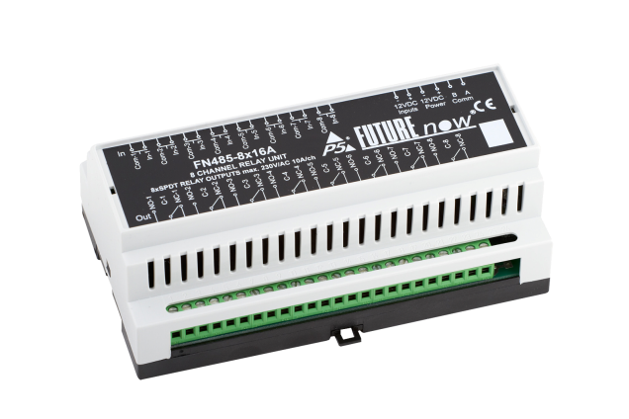
KNX
In 2014, we expand our portfolio with KNX products.

Slide 3
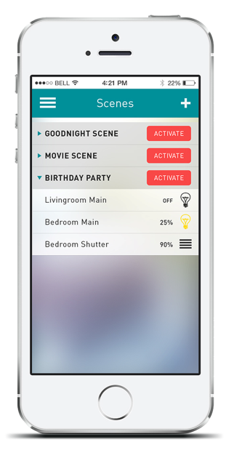
DIY
Simple configuration and control via our free mobile app.
New opportunities in a changing environment.

Slide 4
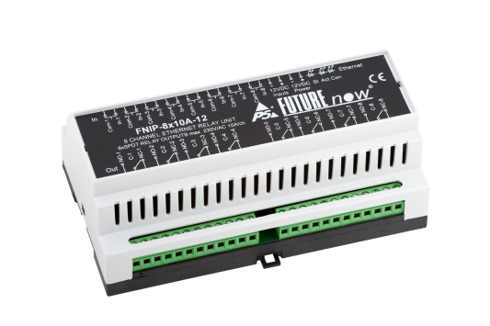
OEM/ODM
We offer OEM and ODM services.
Sell our products under your own brand name.

Slide 5
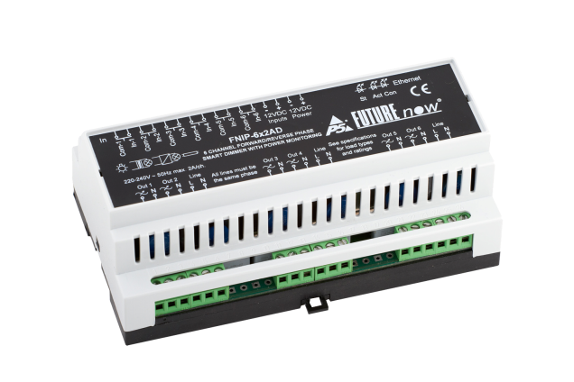
Energy Metering
Minimize you energy footprint.
Our newest smart dimmers provide real time energy consumption data.

Slide 7
F NIP-8x10A
Ethernet Relay Switch
The next generation of multi-channel, DIN Rail mountable relay module, for centralized lighting and general purpose automation

Slide 8
F NIP-6x2AD
Ethernet Smart Dimmer
The next generation of multi-channel, DIN Rail mountable dimmer for all load types, with power consumption monitoring

Slide 9
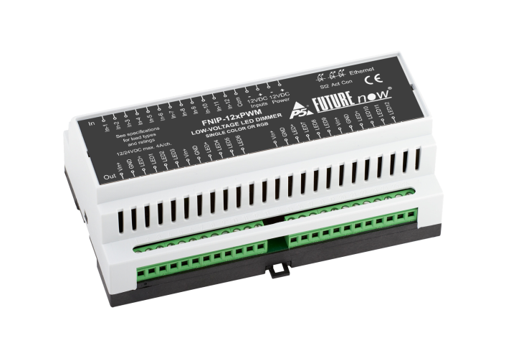
F NIP-12xPWM
Ethernet Low Voltage LED Dimmer
The next generation of multi-channel, DIN Rail mountable dimmer, ideal for single color and RGB LED strips

Slide 10
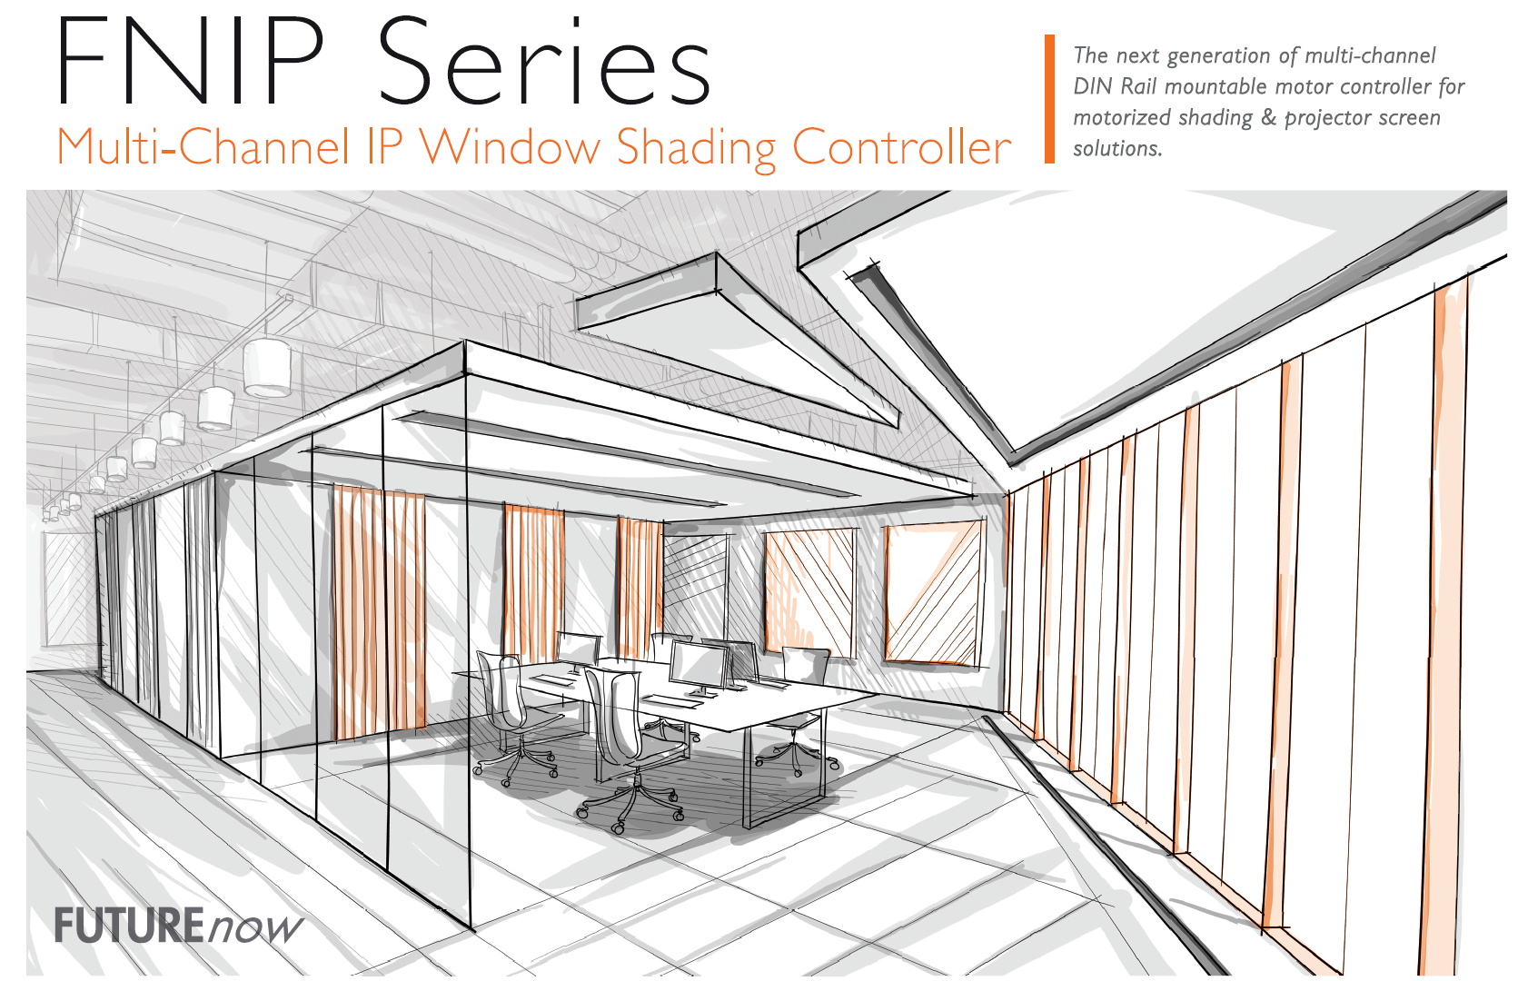

Slide 11
F NIP-4xSH
Ethernet Window Shading Controller
The next generation of multi-channel, DIN Rail mountable, window shading controller for motorized window coverings, awnings and projector screens

Slide 13
F N485-8x16A
Bus Relay Switch
Multi channel, DIN Rail mountable, heavy-duty relay module, for switching any load types

Slide 14
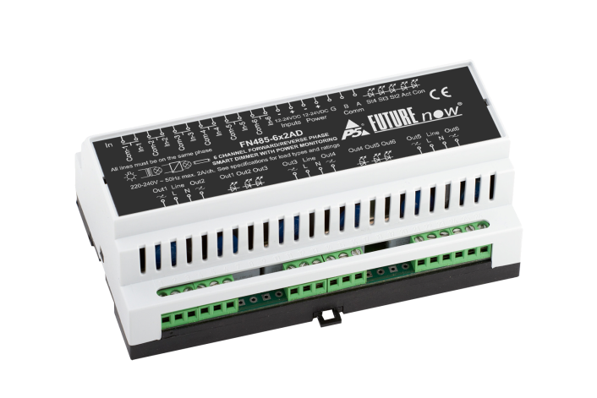
F N485-6x2AD
Bus Smart Dimmer
Multi-channel, DIN Rail mountable, FN485 bus smart dimmer, for all load types and power consumption monitoring

Slide 15
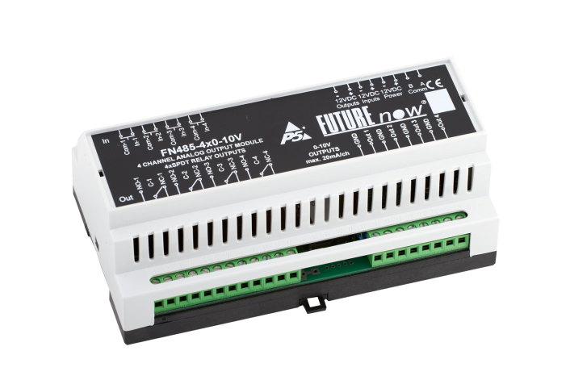
F N485-4x0-10V
Bus Low Voltage LED Dimmer
Multi-channel, DIN Rail Mountable, FN485 bus 0-10V analog output module, for dimming fluorescents and low-voltage LEDs

Slide 16
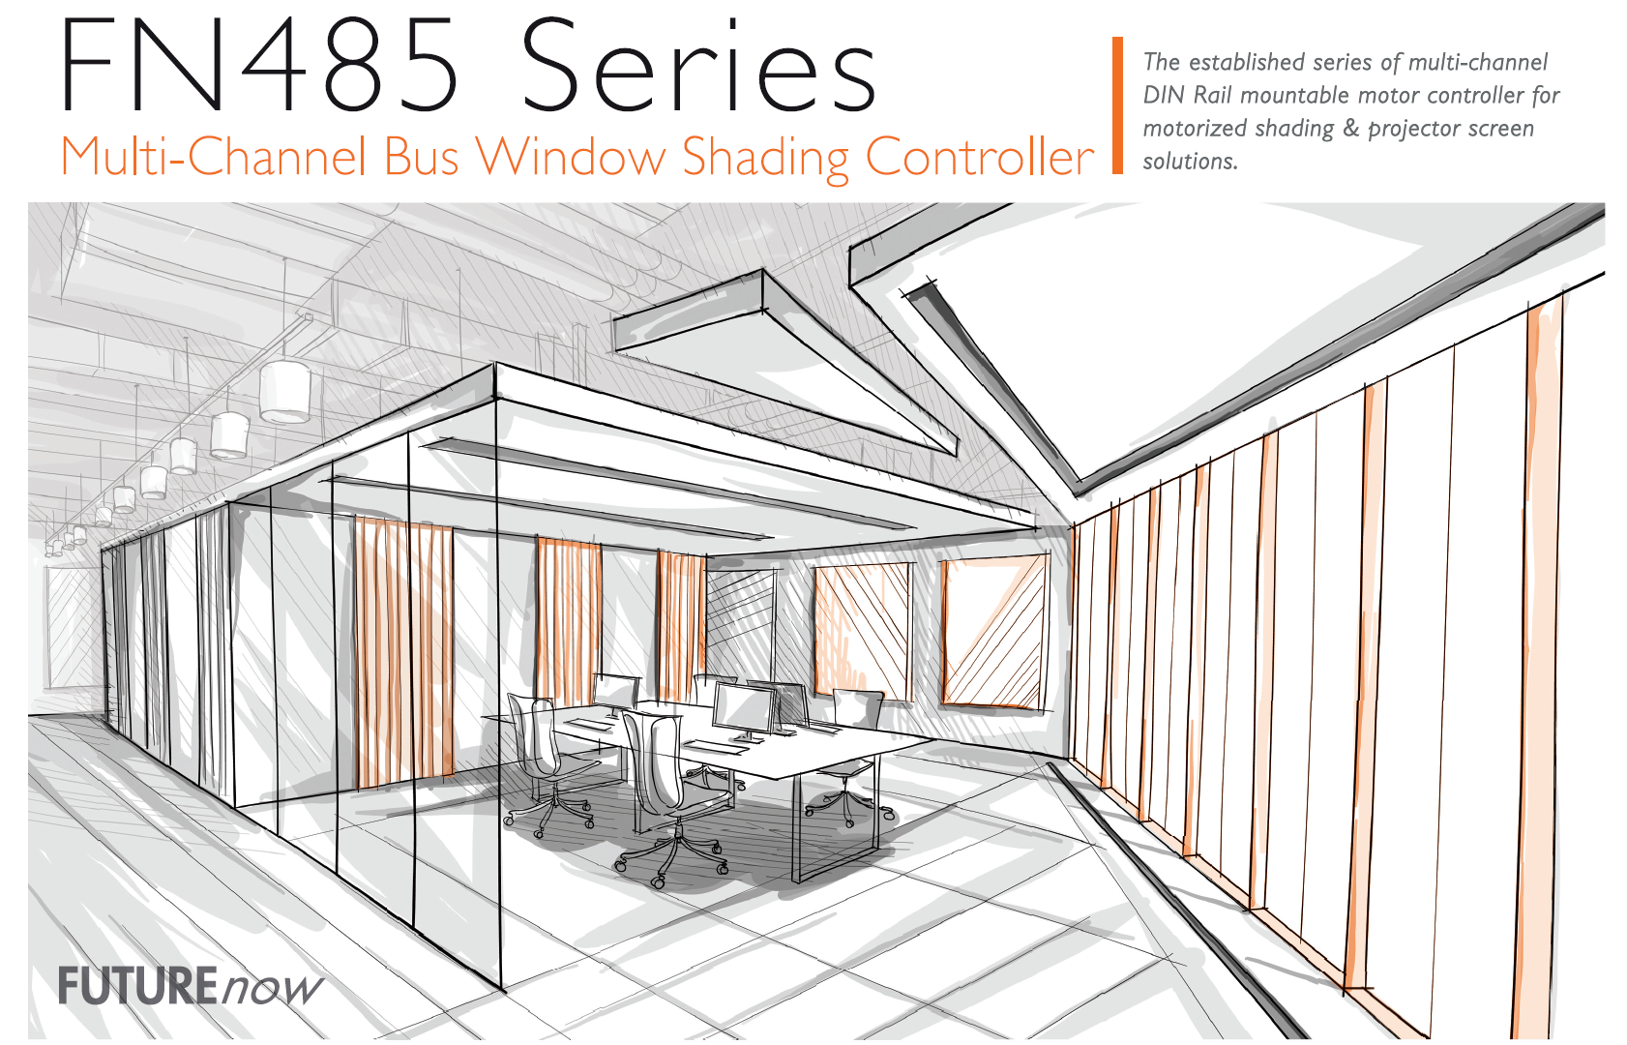

Slide 17
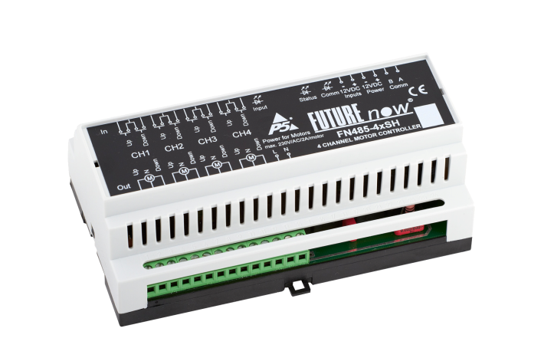
F N485-4xSH
Bus Window Shading Controller
Multi-channel, DIN Rail mountable, FN485 bus window shading controller, for motorized window coverings, awnings and projector screens

Slide 18
www.p5.hu

